Slide 1
Production development
Analyse your
Production
Torgny Veibäck
Notes:
Welcome to This seminar in the field of Production development in The Business Coaching Programme. My name is Torgny Veibäck

Slide 2
A chain of activities
Production development
1 Corinthians 3:6
I, Paul, planted, Apollos watered, but God gave the growth.
All growth is from the Creator. We are the workers in his vineyard.
Also valid for business.
Notes:
Paul was active in founding new congregations as you know. There were an debate about who was doing what and what are they doing. And Paul makes it clear that it is a team work with different duties.: I, Paul planted, Apollos watered and God gave the growth. There is a lesson in this. It’s not one man job. Many duties and skills are needed. And most important: It’s God, the Creator, that gives the growth. We are only workers in the vineyard of the Lord. The same applies to our business. We are working with our business, involving people to do different duties, and expect results: Good products and services, happy clients and in the end money. Of cause the result is not always as good as we wanted. Is God mad at us? Or have we not made our job good enough? Classical question. We need to develop our way of production. Where to start?

Slide 3
Analyse the production
Production development
1 The flow
Where does the flow of material and information get complicated and why? Often at “Handover”-situations.
2 The lead time
Where does the flow of material and information get stuck and why?
Internal “Handover” is a Suppler – Client relation. In every Handover you demand:
No faults
Agreed deliver time
Friendly service
No obstacles, inconveniences
Lead Time = time from first start of a specific order until it finally is delivered and you have got the money
Handover =
Notes:
Basically there are two areas to look at:
1 The Flow of material and information through our business, especially where there are handovers between people. There the most of the mistakes and delays occur. Handover is for example when Sales has managed to get a new order/project to the company hand it over to the “Production planning”. Or men the manufacturer of parts is handing over them to the assembling department to build the product. It is in such “hand-overs” most problems occur.
2 Secondly how long time does it take to produce and deliver an order – That’s the Lead Time. It is the time it takes from you start up on an order until you have delivered this specific order to the customer. This lead time ought to be as short as possible. It’s a kind of measure of the efficiency of your production.
How can we analyse the flow with all the hand-overs and how can we measure the lead time?

Slide 4
Process map
Production development
Map of the activities needed to carry through the production
Direct support activities
(logistics, storing, testing, designing, marketing ...)
Selling
Purchasing
Manufacturing
Controlling
Handovers
Delivering
Invoicing
Lead time
Notes:
We need first to understand the production better – finding out what we actually are doing. Even if you have been producing for several years you don’t know exactly which activities are performed and how they are depending at each other.
This is the kind of map you want to end up with. Notice it’s not a map of the premises or departments like in a layout. It’s about what activities you actually are doing. The direct production activities (the blue boxes) which might look very differently from business to business.
In this map you see very clear where the hand-overs are.
In the picture you may see the Lead time. The time it takes to handle an order all through.
This map which is quite simplified, is drawn by following the material and noticing the activities around the handling of it through all steps in the business.

Slide 5
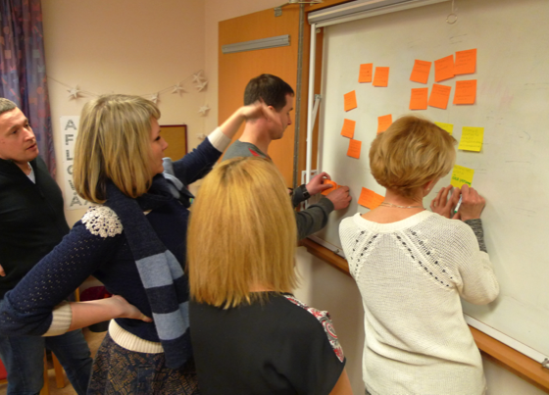
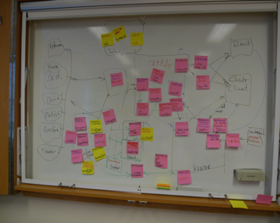
Process mapping
Production development
1 Make a simple flow chart of the direct activities Follow the way of material of an order through all the production processes. Start at the customer and go back to the order-giving and supplier.
Redraw it to make it more clear and understandable
Notes:
Start by drawing a map of the activities needed in the production of a typical product. You might have several different products or services with very different production flows. Start with the most common process you have and include only the direct production and support activities needed to produce it. Gather together at a white board like here and call for the managers of the departments to help you getting it right. There always more activities than you first think of. A tips is to start at the delivery to the customer and follow backwards what have happened during all steps.
You see at the board to the right that it might be much more complicated then the first ideal map I showed you. But if you redraw and simplify the picture from the whiteboard you it will be more clear and understandable. Just the process to do this together is very clarifying in itself.

Slide 6
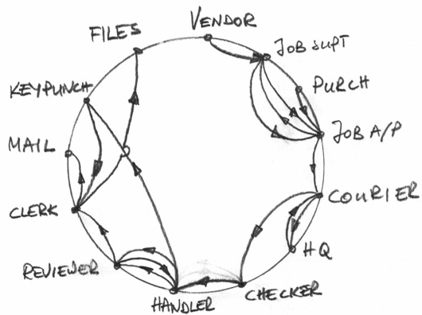
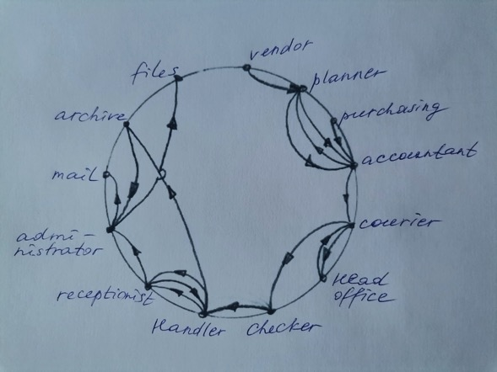
Process mapping
Production development
2 For the information flow it is easer to draw it as a circle.
Notes:
In the first map you followed the material mostly. If you try to get all the flow of information in – documents, mails and phone calls it will be very complicated. To understand and analyse the flow of information this kind of map is easier- You start with drawing a circle and put the different departments/persons involved at the edge. Then you draw the arrows which represent the information flow back and forth. Also this you might redraw to make it clear enough to analyse. Here you will be able to see where you have problem with complicated information flow and where the hand-overs seem risky, where there might be delays etc.

Slide 7
Analyse the Handovers
Production development
Handover situations
Where is the flow complicated?
Where does delays mostly occur?
Where does most mistakes occur?
Internal “Handing over” is a “Suppler – Client” relation.
The same “Customer needs” as externally applies!
No faults
Agreed deliver time
Friendly service
No obstacles, inconveniences
Notes:
To understand where the flow gets complicated and delayed occur is the primer factor to analyse. Both these maps will help you to point out where the risky areas are. Where is the bottleneck where the flow stops and material is queuing? That’s a first of all priority to give more recourses to the bottleneck. Where does mistakes occur? Are they handled and rectified at the same department or does the faults follow the flow to the end of the flow or even to the customer?
You might also recognize the handovers where you have human relation problems. The internal handovers are similar to the external Supplier – Client relation. It has to function well to avoid discontent and bad relations. The customer demand is here as always: No faults, agreed delivery time, friendly service and no obstacles or inconveniences. Bad relations at work may be as disastrous as any physical problem.

Slide 8
Analyse the Lead times
Production development
Lead time
How long is the typical Lead Times?
Where does the flow stop up? Queues?
Which is the bottleneck? Give it more recourses!
Are all activities or “handing overs” actually needed?
Which are the most vulnerable activities? Backup?
Lead Time = time from first start of a specific order until it finally is delivered.
Bottleneck = activity in the flow where a queue of jobs are waiting to be performed
Notes:
The Lead time is the next to be analysed How long is the typical Lead Time? You start with measuring it for a typical order. The time from you start the production planning of a specific order until that order has been delivered to the customer.
How long time does it take? Where does the flow stop up? Are there queues somewhere? Which is the bottleneck? How can you give it more recourses in short and long term? Are all activities or handovers actually needed? Which are the most vulnerable activities? Are there any possibilities to give them back up?

Slide 9
Coaching questions
Production development
How well do you know your production?
Who can I involve doing a mapping of the production?
How will you follow up the Lead Time of a typical product/service?
Notes:
Some coaching questions to discuss with your coach or think over yourself. Thank you and God bless you.

